Slide 1
Law firms – are accountants making the most of this underdeveloped market?
Peter Scott Consulting
www.peterscottconsult.co.uk

Slide 2
Law firm statistics – December 2010
Practising solicitors 120,847 [plus 35,597 non practising]
--------------------------------------------------------------------------------------------------------------------------
Number of firms 10,961 [including 344 LDPs]
Incorporated firms 2,081
LLPs 1,345
Partnerships 3,517
Sole practitioners 3,777
Multinational 151
Other 90
Firms opened in 12 months to 12/10 - 1,126
Firms closed in 12 months to 12/10 - 484
--------------------------------------------------------------------------------------------------------------------------
New admissions 9,136
--------------------------------------------------------------------------------------------------------------------------
Practice Standards Unit [PSU] visits 923
Investigations 7968
SDT orders [including 84 struck off] 353
Interventions [incl. 48 sole practitioners] 64

Slide 3
Law firms are [should be]businesses
What work are you currently doing for your law firm clients?

Slide 4
Law firms’ needs
What work do you not currently do for law firms which
You are skilled at;
You have the resources available; and
it would be profitable work?

Slide 5
Areas of work some accountants are offering law firms
Practice advisory - providing on going advice to you and your firm
Sounding board and trusted adviser
Firm tax advice
Mergers and team acquisitions advice, planning and due diligence
Cash flow management advice
LLP conversions
Service companies
Accounting and tax clauses in partnership/LLP agreements
Tax and financial arrangement of lateral hires and partner retirements
Developing and refining business strategy

Slide 6
Taxation - providing taxation advice to the firm and its partners
Firm’s tax advice
Partner tax advice
Firm tax compliance
Partner tax compliance
Tax reserving
Firm VAT compliance and planning
VAT transaction advice on client matters
Employment taxes advice and compliance

Slide 7
Advice for partners - helping the partners of the firm manage their finances
Personal tax planning
Personal tax compliance
Wealth management
Pension planning
Estate and trust planning

Slide 8
Advice for law firms and their employees - motivating and incentivising staff efficiently
Remuneration planning
Flexible benefits
Employment tax advice
Pension planning
Personal financial planning
Senior staff incentivisation

Slide 9
Risk and efficiency services - helping the firm analyse and manage risk
Risk management
Internal audit
VAT health checks
PAYE settlements and compliance review assistance
Tax risk and investigation services
Forensic accounting services

Slide 10
Outsourcing - where skill set and efficiency savings often mean the law firm does not have to recruit and maintain staff
Preparation of annual statutory accounts
Preparation of management accounts
Preparation of profit share calculations and review of partner current accounts
Tax compliance services
Calculation of partner tax reserves
Payroll preparation and compliance
Company secretarial services
FSA regulatory compliance

Slide 11
How many of those services are you providing your law firm clients?

Slide 12
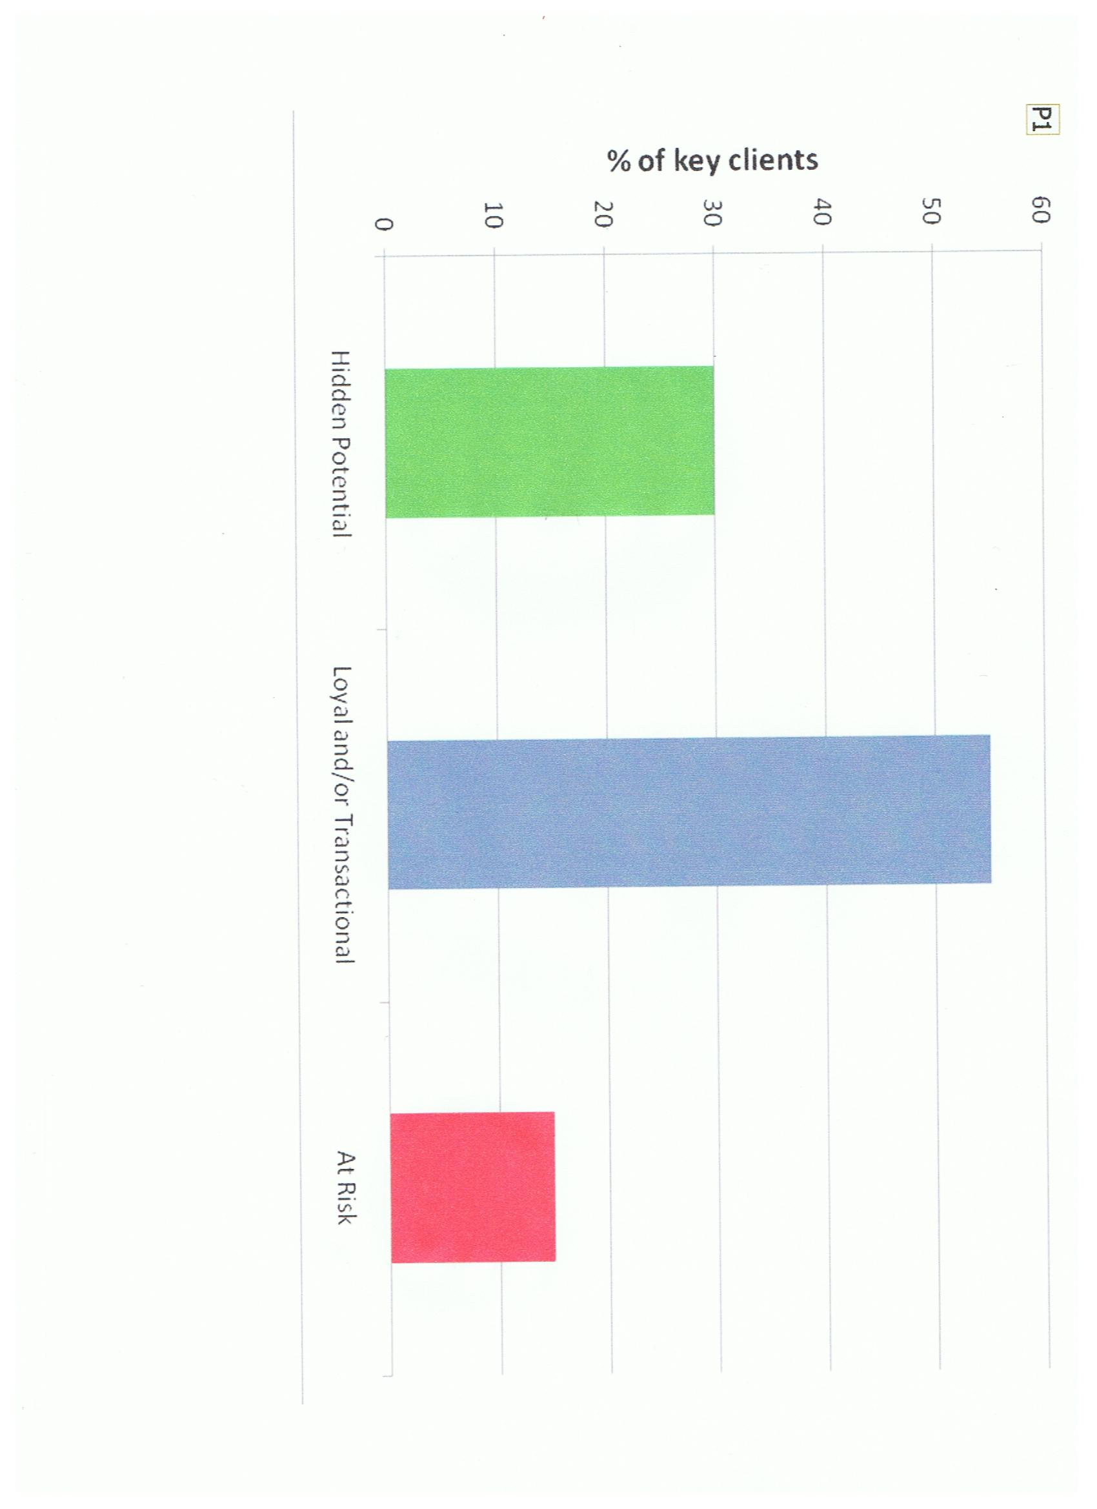
Typical professional firm client profile

Slide 13
Your client base
It is not only the at risk clients you should be concerned about.
The graph shows that typically three out of ten clients have hidden potential to grow that has not been identified.

Slide 14
Law firms’ hidden potential
Do you know the hidden potential for work in the law firms you already act for?

Slide 15
The cost of sales
The cost and effort to ensure client satisfaction and thus the retention and development of clients is many times less than the cost of trying to win new business
Do you know your clients’ hidden potential which could be unlocked for your firm?

Slide 16
Do you know what services law firms are going to need?
How can you find out?

Slide 17
What are law firms looking for?
Core issue is to add value to law firms:
More than and better than the competitors
In a way which:
- is regarded as valuable by law firms; and
- differentiates you in your market – to create your
‘brand’

Slide 18
So what is ‘added value’?

Slide 19
Price on its own is rarely a determining factor
However, value for money is key

Slide 20
You will add value that law firms care about if…
You provide them with what they need
At prices they perceive to be value for money; and
You do this better than your competitors

Slide 21
Value that law firms care about
their perspective
Not your own perspective
Is there a gap?

Slide 22
A value gap?
It is the law firm’s perception of value that matters – not yours
Professionals tend to put too much emphasis on service attributes
Not enough emphasis on helping clients achieve results

Slide 23
Perceived lack of skills and technical expertise
Law firms absolutely expect that accountants have the necessary technical expertise to get the results they require
This should be a given – but unfortunately it is often not the case

Slide 24
Speed and other service factors including
Meeting deadlines
Keeping commitments
Ability to offer advice quickly and efficiently
Keeping clients informed of progress
Care and attention to work
Billing as expected
Personable and likeable people / rapport with the team
Interest in / knowledge of client’s business

Slide 25
Positioning your practice to be competitive by adding value to law firms more than your competitors (Brown and Faulkner 1994, Long Range Planning)
High
Client
Perceived
Added
Value
Ave
X
Suicide Zone
Low
Low
Ave
High
Client Perceived Cost

Slide 26
External perceptions of your firm?
Would your law firm clients say you are adding value?

Slide 27
And you should not forget that law firms are also referrers of work
What factors do referrers of work take into account when choosing to whom to send work?

Slide 28
Research indicates that referrers consider these factors important
Knowing the individual / the personal relationship / having confidence in the individual
Expertise / technical ability / good quality advice
Track record in an area of work
Turnaround time / speed / ability to meet deadlines
A fit with client
Location
Reciprocation
Working as a team

Slide 29
Your firm
For any individual firm it is key to identify what is important to your clients and referrers of work and how you perform in key areas
Understanding and then responding to the issues can create immediate financial benefit and clarify the future direction of your firm

Slide 30
To be unaware of or to ignore client and referrer perceptions is to put at risk a firm’s very existence

Slide 31
A great opportunity now beckons…
Outcome O(7.4) of the new SRA Code
“You maintain systems and controls for monitoring the financial stability of your firm……. and you take steps to address issues identified”

Slide 32
And it gets better….
Outcome O(10.3) says
“you notify the SRA promptly of any material changes to relevant information about you including serious financial difficulty…”

Slide 33
Indicative behaviours in the new Code say that acting, inter alia, in the following ways may tend to show that you have achieved outcomes…

Slide 34
IB(10.2) “actively monitoring your financial stability and viability in order to identify and mitigate any risks to the public”

Slide 35
IB(10.3) “notifying the SRA promptly of any indicators of serious financial difficulty, such as inability to pay your professional indemnity insurance premium, or rent or salaries, or breach of bank covenants”

Slide 36
IB(10.4) “notifying the SRA promptly when you become aware that your business may not be financially viable to continue trading as a going concern, for example because of difficult trading conditions, poor cash flow, increasing overheads, loss of managers or employees and / or loss of sources of revenue”

Slide 37
IB(10.5) “notifying the SRA of any serious issues identified as a result of monitoring referred to in ….. IB(10.2) above, and producing a plan for remedying issues that have been identified”

Slide 38
Law firms will need a compliance plan to do this
Your challenge
How are you going to proactively seek to win this work?

Slide 39
Any questions?

